Slide 1
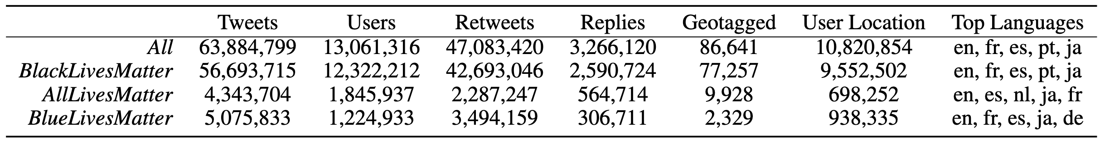
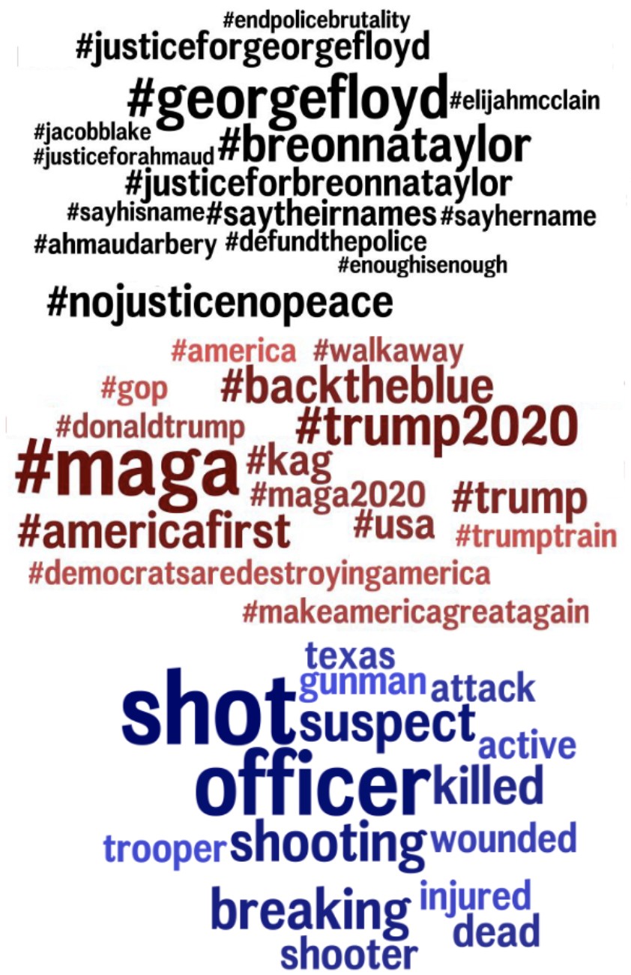
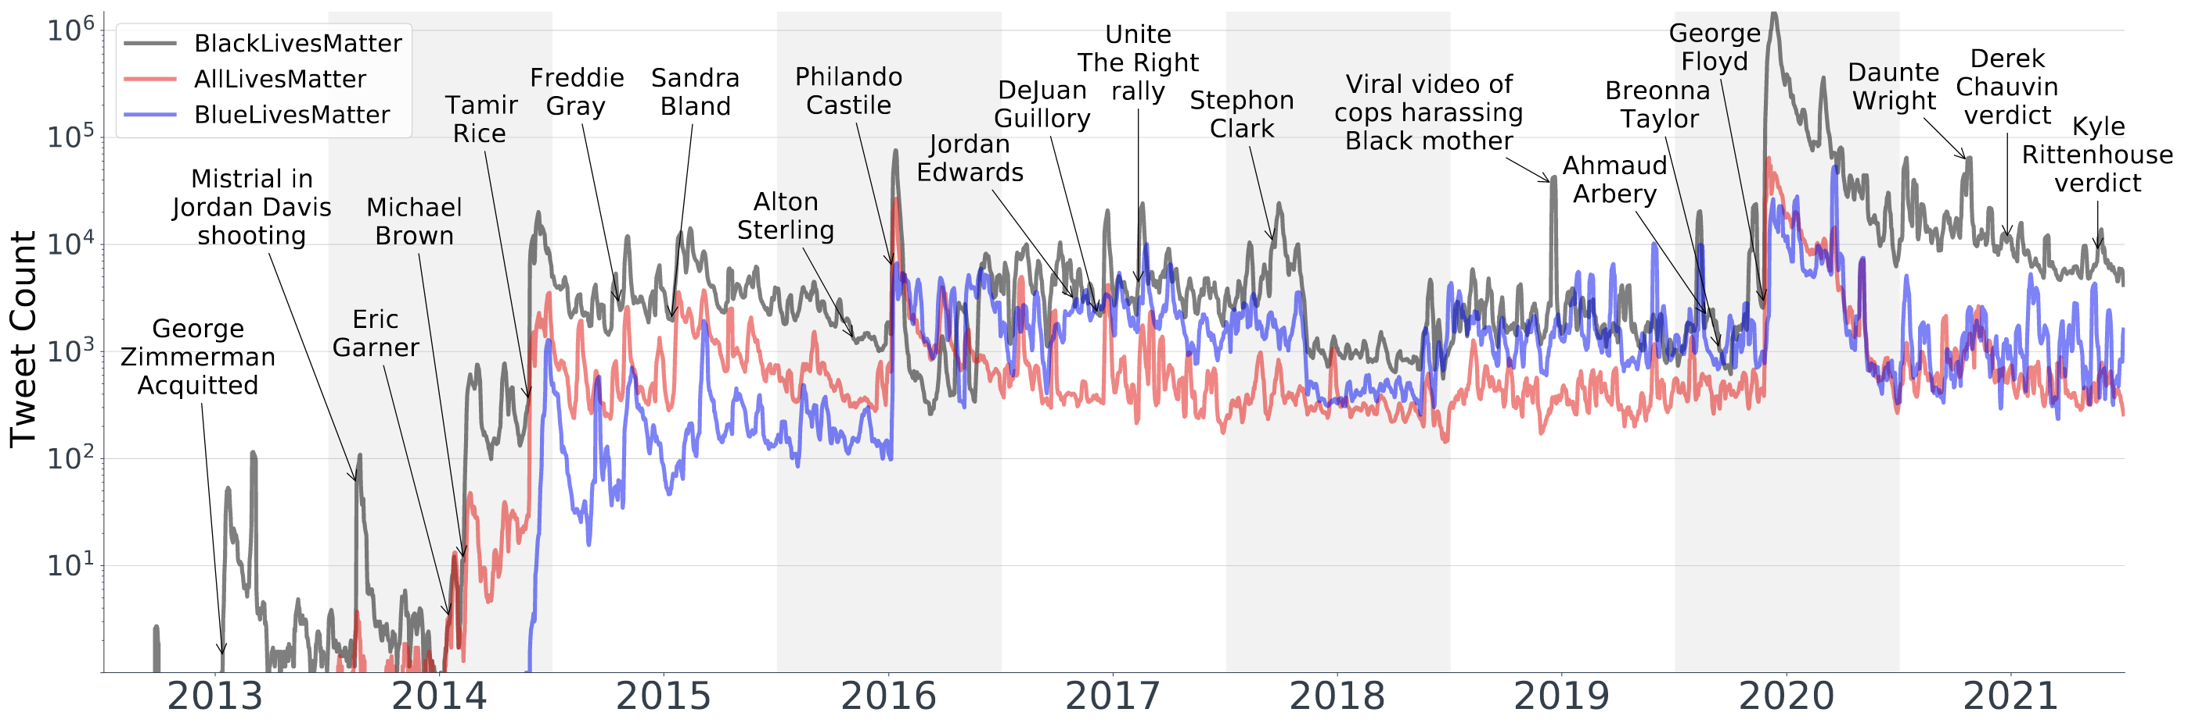
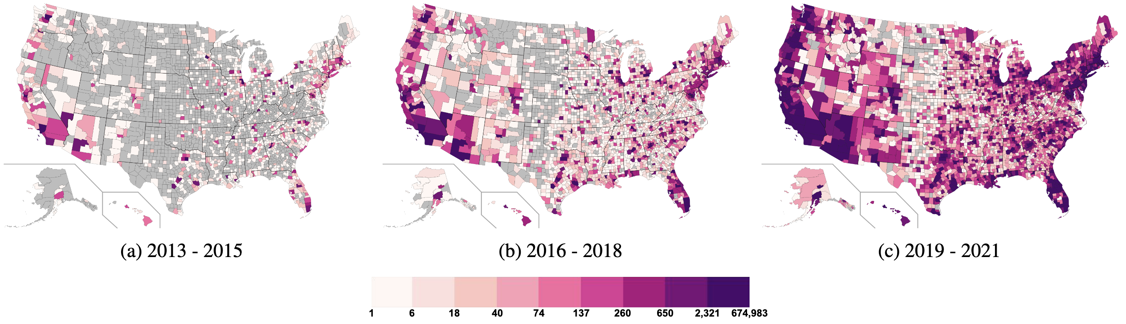
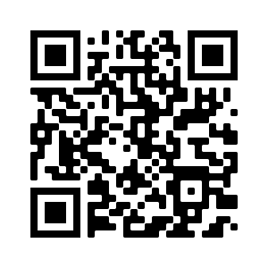
Twitter Corpus of the #BlackLivesMatter Movement And Counter Protests: 2013 to 2021
Salvatore Giorgi,^{1,2} Sharath Chandra Guntuku,¹ McKenzie Himelein-Wachowiak,² Amy Kwarteng,²
Sy Hwang,¹ Muhammad Rahman,² Brenda Curtis²
¹University of Pennsylvania, ²National Institute on Drug Abuse
Introduction
LDA Topics
Black Lives Matter (BLM) is a decentralized social movement protesting violence against Black individuals and communities, with a focus on police brutality
Movement gained significant attention following the murders of Ahmaud Arbery, Breonna Taylor, and George Floyd in 2020
Police violence toward Black individuals perpetuates negative mental and physical health
Table: Descriptive counts for the entire data set and each keyword
Data Collection
Data pulled continuously from June 2016 to Dec. 2021 using official Twitter API
Pre-June 2016 data was pulled using the GetOldTweets Python package
All tweets contain some variation of one of three keywords: BlackLivesMatter, AllLivesMatter, BlueLivesMatter
Figure 1: Seven day moving average of monthly tweet count from 2013 to 2021
Figure 3: Most frequently used topic for each keyword
Ethics Statement
Data and Software
Only public tweets IDs are made available, no raw or inferred data is shared
While all tweets are publicly available, users did not consent to share data
Hydrated data may contain identifying information
Authors do not intend to draw equivalences between counter protests and BLM
Data is available on Zenodo: zenodo.org/record/5835260
Software for hydrating tweets: github.com/sjgiorgi/blm_twitter_corpus
Figure 2: Distribution of BlackLivesMatter tweets across the United States for three 3-year periods: 2013 to 2015, 2016 to 2018, and 2019 to 2021

